Slide 1

6th Grade Math
Unit 4, Lesson 5 Plotting, Ordering, and Comparing Rational Numbers – Part 2 Volume 1, pg. 156

Slide 2


Benchmark
MA.6.NSO.1.1
Extend previous understanding of numbers to define rational numbers. Plot, order, and compare rational numbers.
volume 1, pg. 156

Slide 3
Integrated Mathematical Thinking and Reasoning Standards
MA.K12.MTR.2.1 Demonstrate understanding by representing problems in multiple ways.
MA.K12.MTR.4.1 Engage in discussions that reflect on the mathematical thinking of self and others.
volume 1, pg. 156

Slide 4

Learning Target
I can plot, compare, and order rational numbers.
volume 1, pg. 156

Slide 5

Warm-Up
volume 1, pg. 156

Slide 6
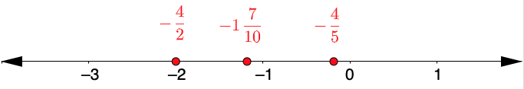
4.5.1 Warm-Up: Find the Error
A student plotted the following numbers.
Which values are plotted correctly?
Which values are NOT plotted correctly?
volume 1, pg. 156

Slide 7

Activity
volume 1, pg. 157

Slide 8

4.5.2 Activity: Class Number Line
Your teacher will give you a sticky note with a rational number written on the front.
Write your name on the back of the sticky note and place your number in the correct location on the class number line.
volume 1, pg. 157

Slide 9

Exploration
volume 1, pg. 157

Slide 10


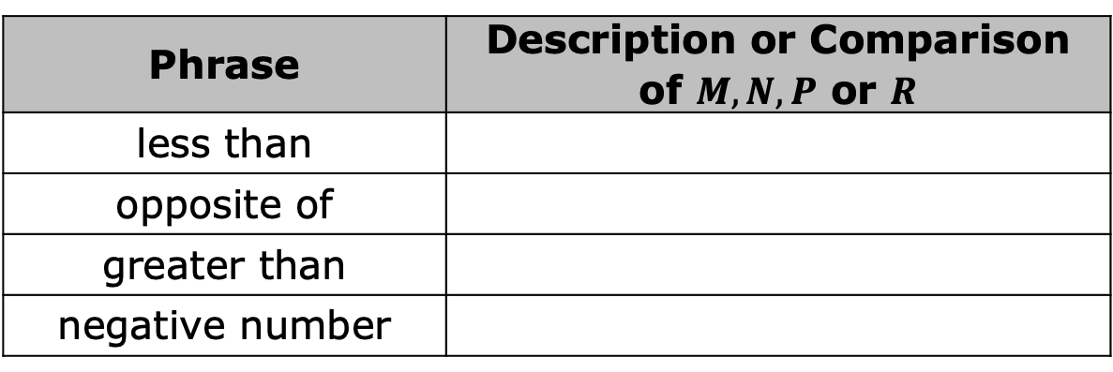
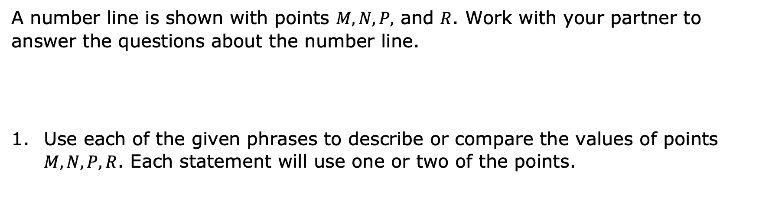
4.5.3 Exploration: Comparing Points on a Number Line
A number line is shown with points $M, N, P,$ and $R$. Work with your partner to answer the questions about the number line.
Use each of the given phrases to describe or compare the values of points $M, N, P, R$. Each statement will use one or two of the points.
Phrase | Description or Comparison of $M, N, P$ or $R$
less than
opposite of
greater than
negative number
volume 1, pg. 157

Slide 11
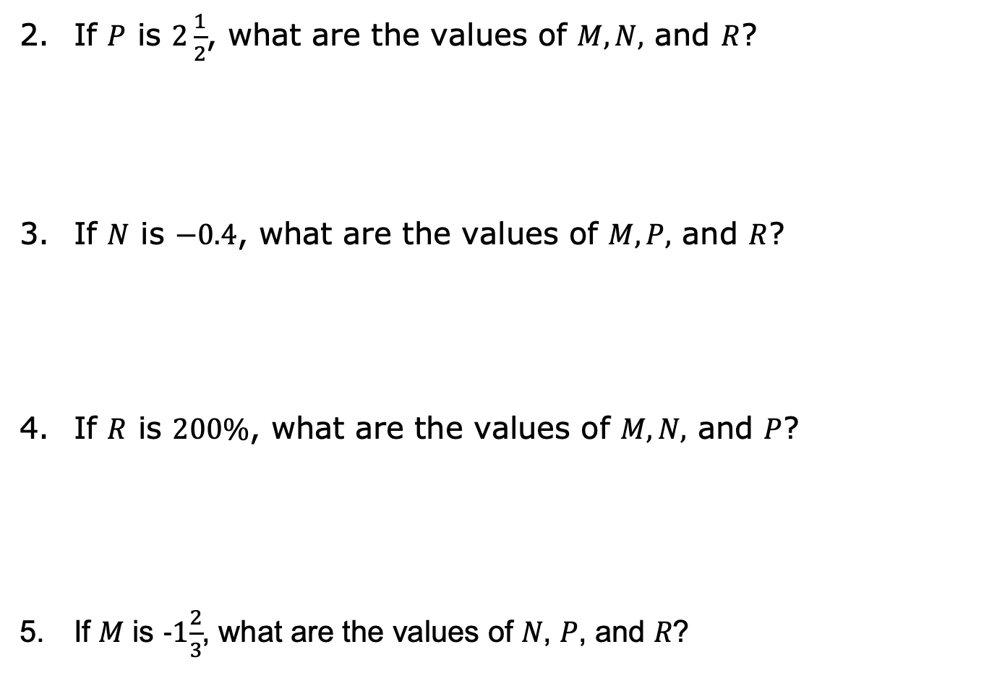
If $P$ is $2\frac{1}{2}$, what are the values of $M, N,$ and $R$?
If $N$ is $−0.4$, what are the values of $M,P,$ and $R$?
If $R$ is $200\%$, what are the values of $M, N,$ and $P$?
If 𝑀 is -1$\frac{2}{3}$, what are the values of 𝑁, 𝑃, and 𝑅?
volume 1, pg. 157

Slide 12

Guided Instruction
volume 1, pg. 158

Slide 13
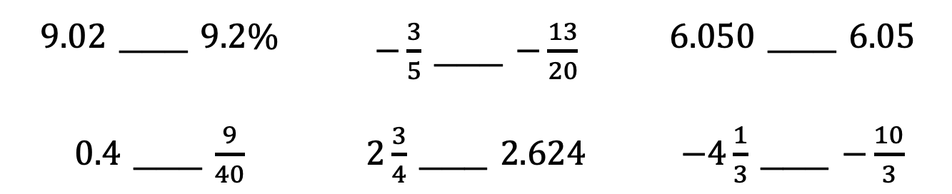
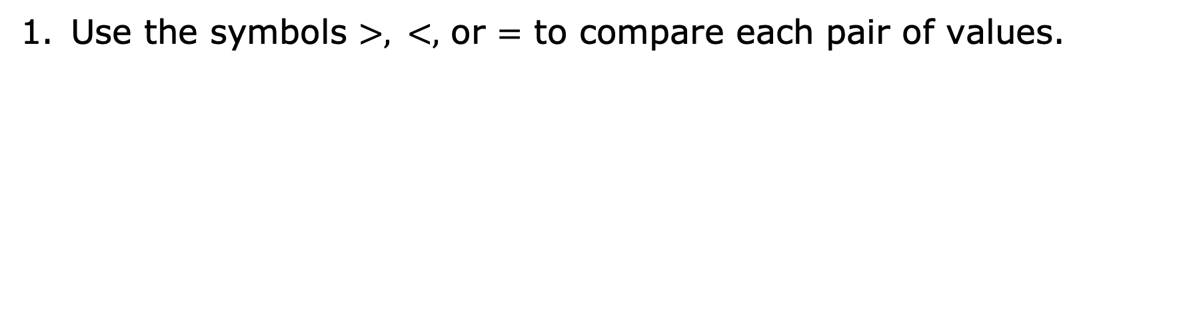
4.5.4 Guided Instruction: Comparing Rational Numbers in Different Forms
Use the symbols $>, <,$ or $=$ to compare each pair of values.
$9.02$ ___ $9.2\%$ | $−\frac{3}{5}$ ___ $−\frac{13}{20}$ | $6.050$ ___ $6.05$
$0.4$ ___ $\frac{9}{40}$ | $2\frac{3}{4}$ ___ $2.624$ | $−4\frac{1}{3}$ ___ $−\frac{10}{3}$
volume 1, pg. 158

Slide 14
Emma and Noah shared their strategy for comparing values written as fractions. Write your strategy in the box and note any differences from Emma’s or Noah’s strategy.
Emma’s Strategy | Noah’s Strategy
When Emma compares a negative fraction to a negative fraction, she starts by thinking about which whole numbers each fraction lies between and which each is closest to. | When Noah compares a negative fraction to a negative fraction, he uses common denominators.
volume 1, pg. 158

Slide 15
Angel and Sophia share their strategies for comparing a value written as a decimal to a value written as a fraction. Write your strategy in the box and note any similarities from Angel’s or Sophia’s strategy.
Angel’s Strategy | Sophia’s Strategy
When Angel compares a positive decimal to a positive fraction, he rewrites the fraction as an equivalent decimal. | When Sophia compares a positive decimal to a positive fraction, she plots them on a number line.
volume 1, pg. 159

Slide 16

Try It
volume 1, pg. 159

Slide 17

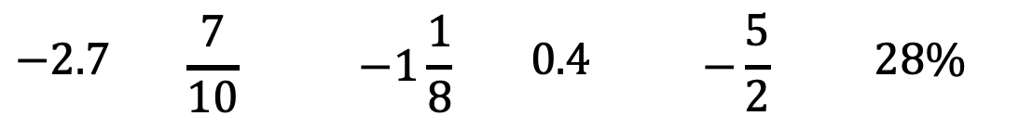
4.5.5 Try It: Plotting, Ordering, and Comparing Rational Numbers in Different Forms
Plot each value on the number line. Label each point with its numeric value.
What strategies did you use that were helpful when plotting the rational numbers written in different forms on the number line?
$$−2.7$$ | $$\frac{7}{10}$$ | $$−1\frac{1}{8}$$ | $$0.4$$ | $$−\frac{5}{2}$$ | $$28\%$$
volume 1, pg. 159

Slide 18
Order the values from greatest to least.
Complete the inequality statement to show the relationship between the values plotted on the number line.
_____< _____< _____< _____< _____< _____
volume 1, pg. 159

Slide 19

Your Turn
volume 1, pg. 160

Slide 20
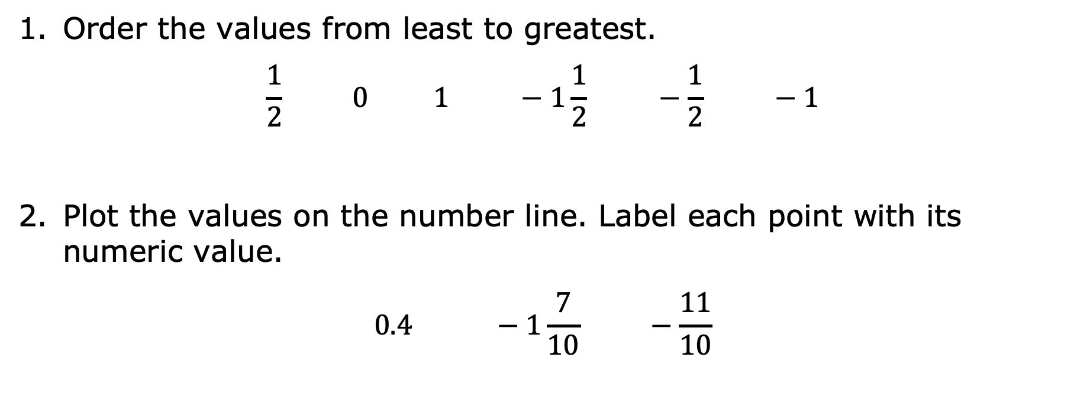
4.5.6 Your Turn!
Order the values from least to greatest.
$$\frac{1}{2} 0 1 −1\frac{1}{2} −\frac{1}{2} −1$$
Plot the values on the number line. Label each point with its numeric value.
$$0.4 −1\frac{7}{10} −\frac{11}{10}$$
volume 1, pg. 160

Slide 21
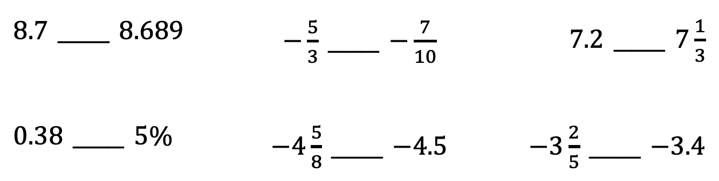
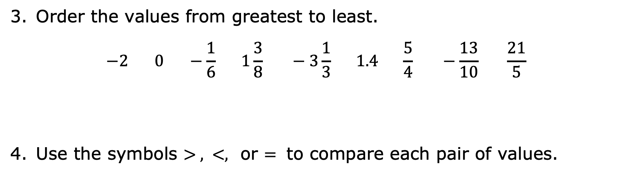
Order the values from greatest to least.
$$−2 0 −\frac{1}{6} 1\frac{3}{8} −3\frac{1}{3} 1.4 \frac{5}{4} −\frac{13}{10} \frac{21}{5}$$
Use the symbols $> , <,$ or $=$ to compare each pair of values.
$8.7$ ___ $8.689$ | $−\frac{5}{3}$ ___ $−\frac{7}{10}$ | $7.2$ ___ $7\frac{1}{3}$
$0.38$ ___ $5\%$ | $−4\frac{5}{8}$ ___ $−4.5$ | $−3\frac{2}{5}$ ___ $−3.4$
volume 1, pg. 160

Slide 22

Wrap-Up
volume 1, pg. 160

Slide 23
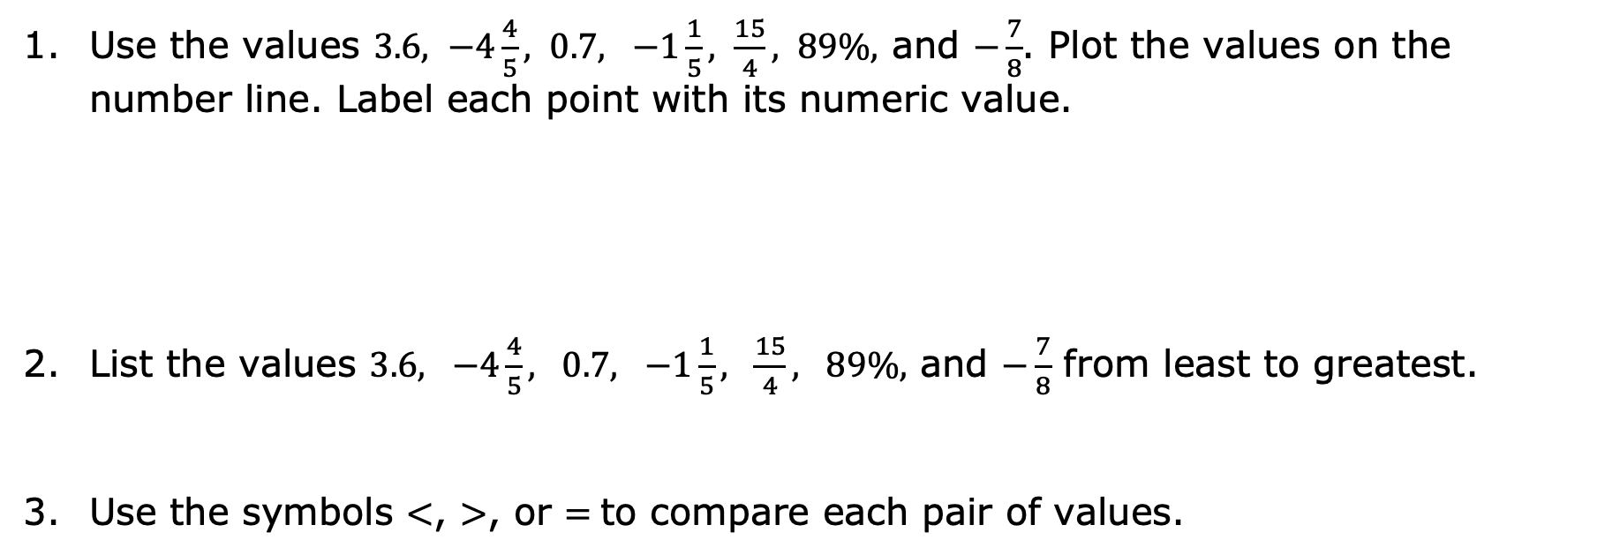
4.5.7 Wrap-Up: Ticket Out the Door
Use the values $3.6, −4\frac{4}{5}, 0.7, −1\frac{1}{5}, \frac{15}{4}, 89\%,$ and $−\frac{7}{8}$. Plot the values on the number line. Label each point with its numeric value.
List the values $3.6, −4\frac{4}{5}, 0.7, −1\frac{1}{5}, \frac{15}{4}, 89\%,$ and $−\frac{7}{8}$ from least to greatest.
Use the symbols $<$, $>$, or $=$to compare each pair of values.
$−12.742$ ___ $−12.9$ | $1\frac{2}{9}$ ___ $150\%$ | $3\frac{7}{12}$ ___ $3.7$
volume 1, pg. 160

